Slide 1
Week 7. Modeling Ecological Niches
A. Michelle Lawing, PhD
Associate Professor
Paleobiology, Evolution, and Climate Lab
Ecology and Conservation Biology
Texas A&M University
alawing@tamu.edu

Slide 2
Welcome, hello, any announcements?

Slide 3
Project Milestones
Date | Milestone
Sept. 11 | Project topic
Oct. 2 | Data plan
Oct. 23 | Modeling plan
Nov. 6 | Preliminary results
Dec. 1 (optional) | Full final draft due
Dec. 10 1-3 pm (finals slot) | Presentation
Dec. 11 | Final paper

Slide 4
Class Plan
Tuesday Lecture over Peterson et al. Chapter 7
Data Plan and Lab 04 review (Thursday or Tuesday)
Lab 05 will roll out next week, due that Friday

Slide 5
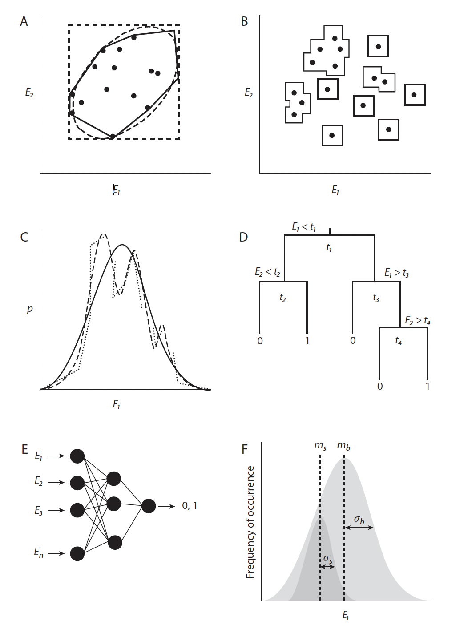
Modeling Ecological Niches
Niche modeling uses occurrence records and environmental data to estimate relationships between species and environments.
That function (relationship) is estimated in E-space and can then be projected back into G-space.

Slide 6
Artificial neural
network
BIOCLIM
Domain
GLM,
GAM,
MARS
Ecological niche
factor analysis
Classification
tree

Slide 7
Modeling goals
Most people get lost in choosing an algorithm, but really we need to focus on what we want to estimate and why.
Ask is the goal prediction or explanation or both? That will help you determine which choices work best for your application.

Slide 8
What do you want to estimate?
“Probability of occurrence” and “habitat suitability” are not interchangeable.
Different data and algorithms estimate different quantities.
A model may estimate:
  Probability of occurrence at a site
  Relative environmental suitability
  Environmental similarity to known occurrences
  Membership in a predicted suitable set
Interpretation must match the data, algorithm, and study region.

Slide 9
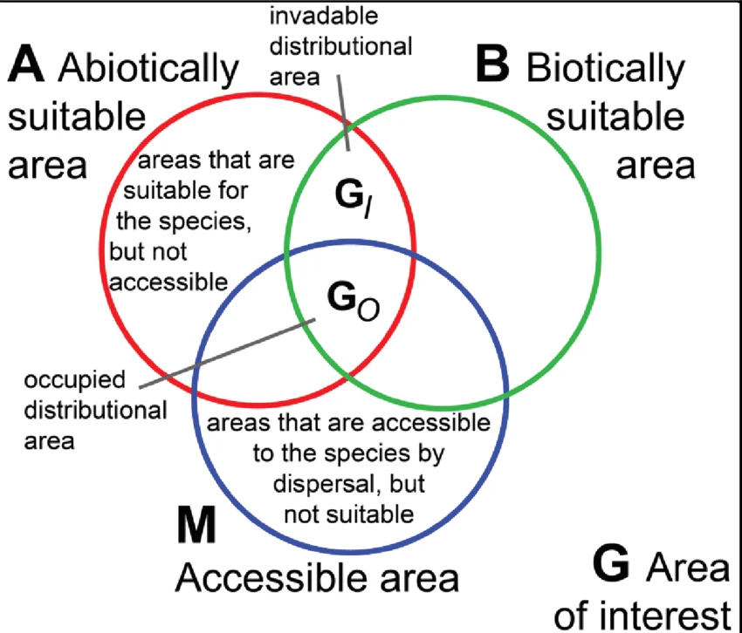
What are you trying to model: niche or distribution?
Ecological niche modeling focuses on environmental conditions associated with persistence.
Species distribution modeling additionally accounts for accessibility, dispersal limitation, and biotic interactions.
A map of predicted suitability is not the species distribution.

Slide 10
The algorithm is one of many decision
A modeling algorithm estimates a relationship between occurrences and environmental predictors.
Important decisions occur before and after running the algorithm:
  What region represents M?
  Which environmental variables are biologically meaningful?
  What occurrence data are reliable?
  How will the model be calibrated?
  How will continuous predictions be interpreted or thresholded?
A sophisticated algorithm cannot rescue weak choices in your workflow.

Slide 11
Model types based on occurrence data
Presence-only methods use occurrence locations without comparison locations.
Presence–absence methods contrast known presences with credible absences.
Presence–background methods compare occurrence environments with environments available across the study region.
Presence–pseudoabsence methods compare presences with sampled locations where the species has not been recorded.
“Background” and “pseudoabsence” points are not confirmed absences.

Slide 12
Families of modeling methods
Envelope and profile methods define environmental conditions similar to observed occurrences.
Regression methods estimate relationships between occurrence and predictor variables.
Classification trees and machine-learning methods can fit complex responses and interactions.
Maxent uses presence records and environmental background to estimate a relative distribution of suitable conditions.
Method choice should follow the question, data type, assumptions, and desired interpretation.

Slide 13
Model calibration
Calibration adjusts model settings so predictions fit observations without becoming overly specific.
Default software settings are starting points, not your necessary scientific justification.
Calibration commonly involves:
  Data splitting
  Tuning model complexity
  Variable selection
  Threshold selection
Internal held-out data can help detect overfitting, but cannot remove biases shared by all records.

Slide 14
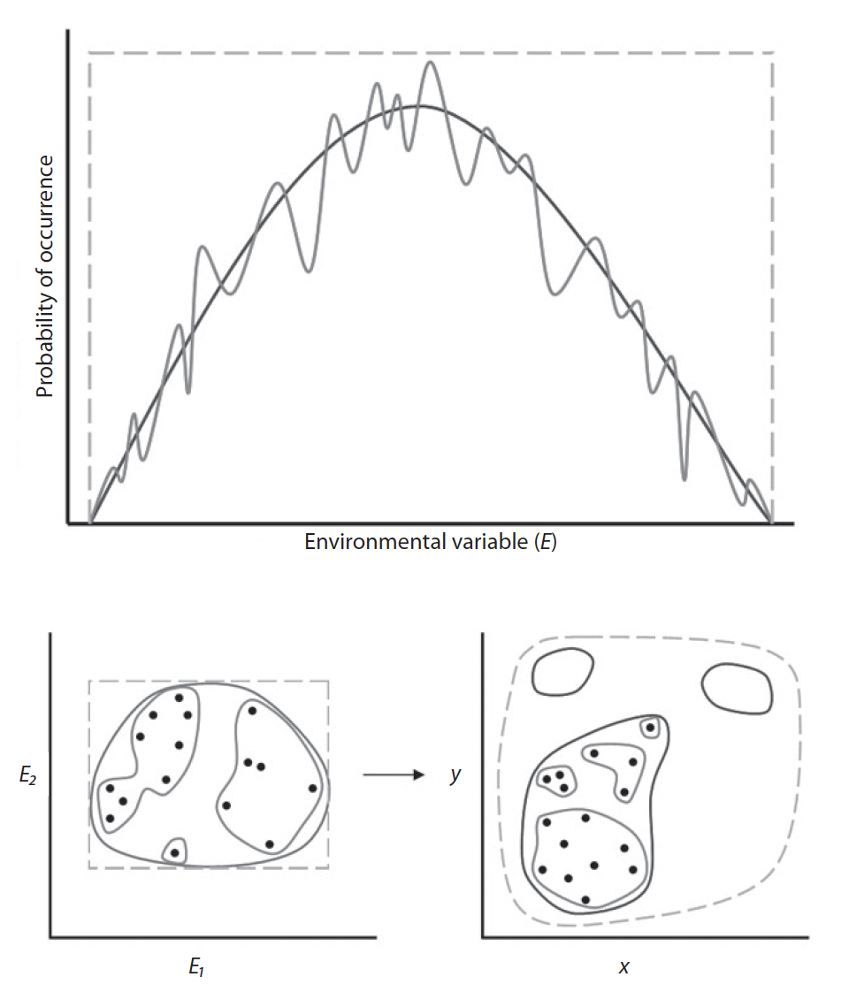
Model complexity and overfitting
Simple models may miss real ecological responses and predict overly broad suitable areas.
Highly complex models can fit known occurrences extremely closely.
Overfitting occurs when a model performs well on training data but poorly on new data.
The goal is an intermediate level of complexity that generalizes beyond the calibration records.

Slide 15
Risk of overfitting
More predictors
More flexible response curves
Few occurrence records

Slide 16
Choosing environmental predictors
Begin with ecological reasoning: which variables could limit the species?
More variables do not necessarily produce a better model.
Correlated predictors obscure interpretation of variable importance.
Fewer, biologically defensible predictors improve interpretability and reduce overfitting.
Variable importance depends on the other predictors included in the model.

Slide 17
Jackknifing predictors
Helps evaluate the contribution of environmental predictors
Build a series of models in which each predictor is:
  used by itself
  left out while all other predictors are retained
  compared with the model containing all predictors
So it helps to answer: What does this predictor contribute on its own, and what unique information is lost when I remove it?

Slide 18
Determining predictor importance
A predictor may be particularly informative when:
  the model performs well using that variable alone, and
  model performance drops substantially when that variable is omitted.
Jackknifing can help with model calibration, but it should not replace biological reasoning.
Use it alongside questions such as:
  Is the predictor biologically meaningful?
  Is it direct, indirect, or resource-related?
  Is it redundant with another predictor?
  Does its apparent importance depend on the study region?
  Will the relationship make sense when the model is transferred?

Slide 19
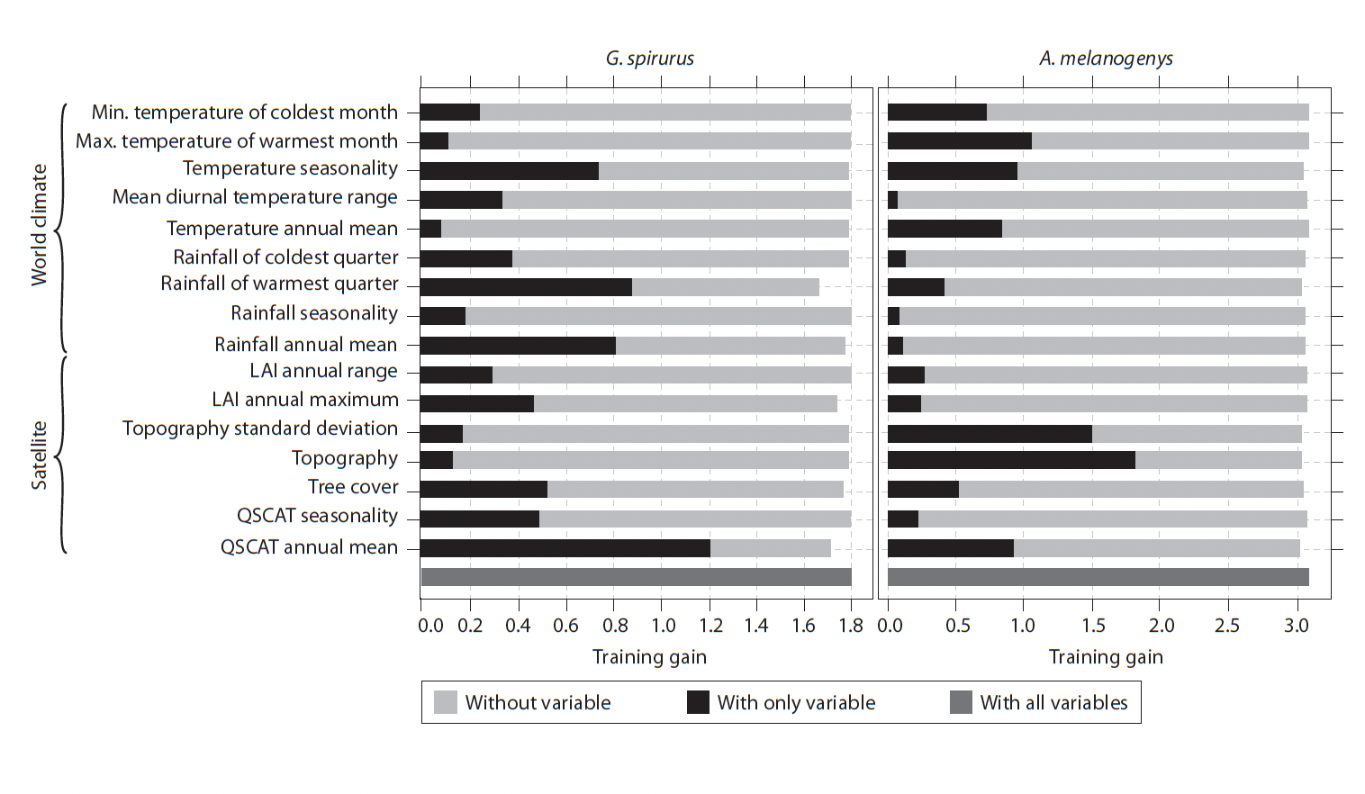

Slide 20
Thresholds
Many models produce continuous suitability values rather than presence–absence predictions.
A threshold converts continuous output into a binary map of “suitable” and “unsuitable.”
Higher thresholds produce smaller, more restrictive predicted areas.
Lower thresholds produce broader predicted areas and reduce omission of potential habitat.
Choose thresholds based on the application and the relative cost of omission versus commission errors.
Avoid using a default threshold such as 0.5 without justification.

Slide 21
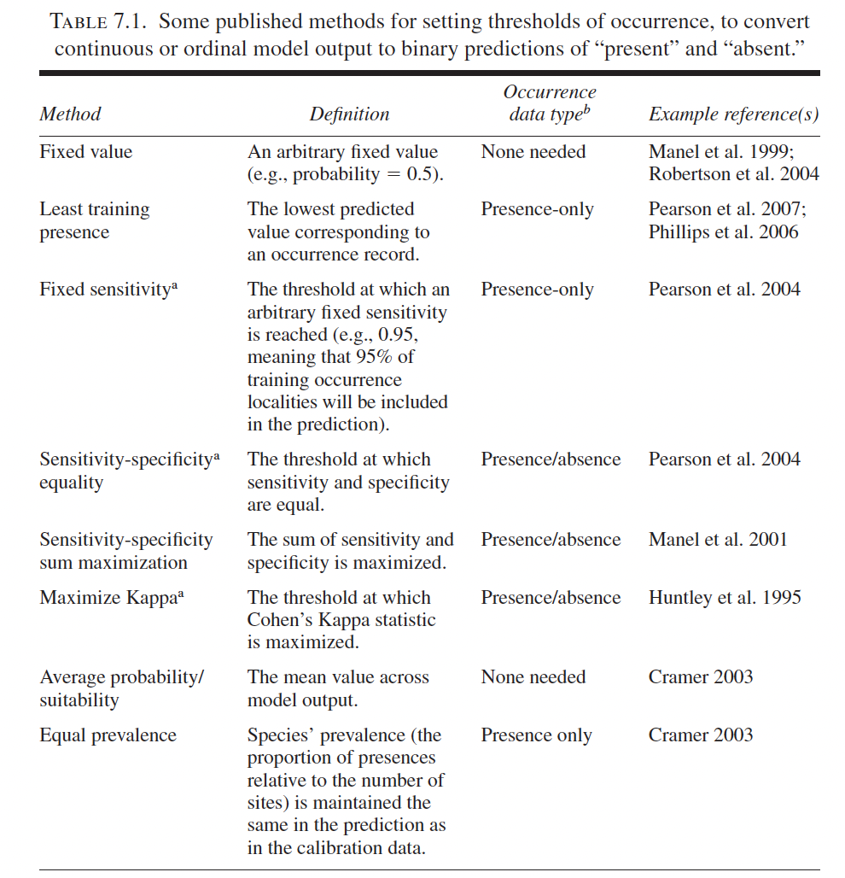

Slide 22
M matters
For background, pseudoabsence, and absence-based models, the calibration region approximates M.
The assumption is that areas outside M lack the species because of dispersal barriers or history, not unsuitable environment.
Treating those outside M areas as unsuitable can create misleading model relationships.
The accessible area is therefore a biological hypothesis that affects model results.

Slide 23
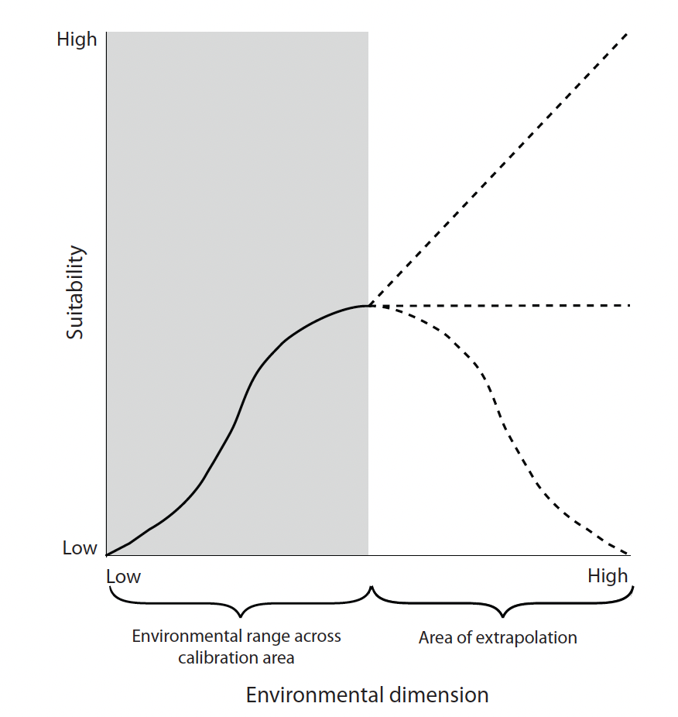
Extrapolation
Extrapolation occurs when a model predicts into environmental conditions not represented during calibration.
Predictions under novel climates or in a new geographic region may require extrapolation.

Slide 24
Transferability
Transferability means applying a model to another place or time.
Transferability is more credible when the model avoids overfitting and the new area contains familiar environmental conditions.
Predictions in novel environmental space deserve explicit caution.

Slide 25
Is there a “best” algorithm?
Different methods can produce very different predictions from the same data.
No algorithm is universally best.
Model comparisons depend on:
  The ecological question
  The occurrence data available
  The calibration region
  The evaluation method
  The consequences of error
A model should be judged against the purpose of the analysis.
Performance metrics help, but only if they are aligned with the purpose of the analysis.

Slide 26
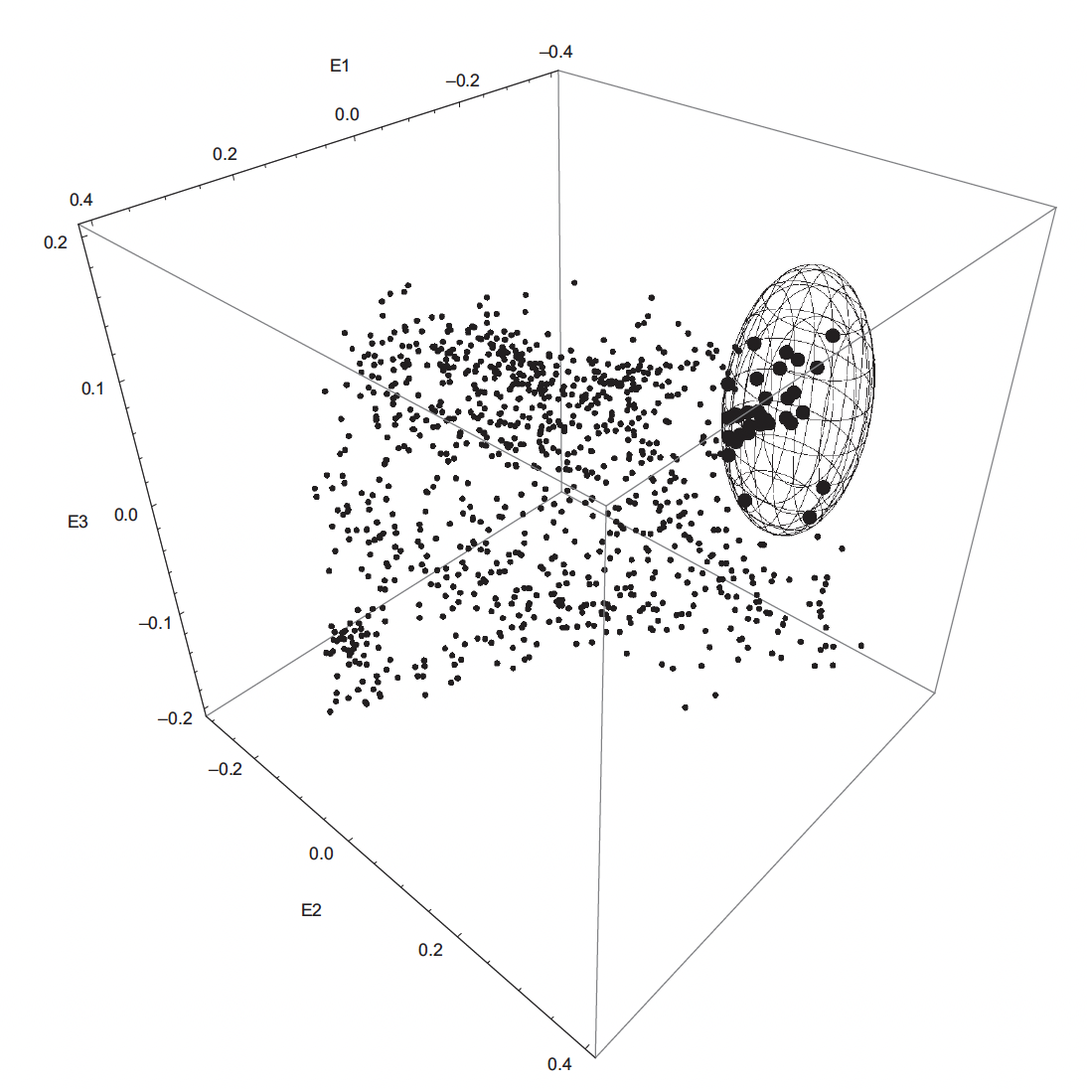
Characterizing niches in environmental space
Estimated niches occupy a subset of multidimensional environmental space.
Niche comparisons can consider
  Position: where the niche is located or centered
  Size: how much environmental space it occupies
  Shape: how environmental conditions are combined

Slide 27
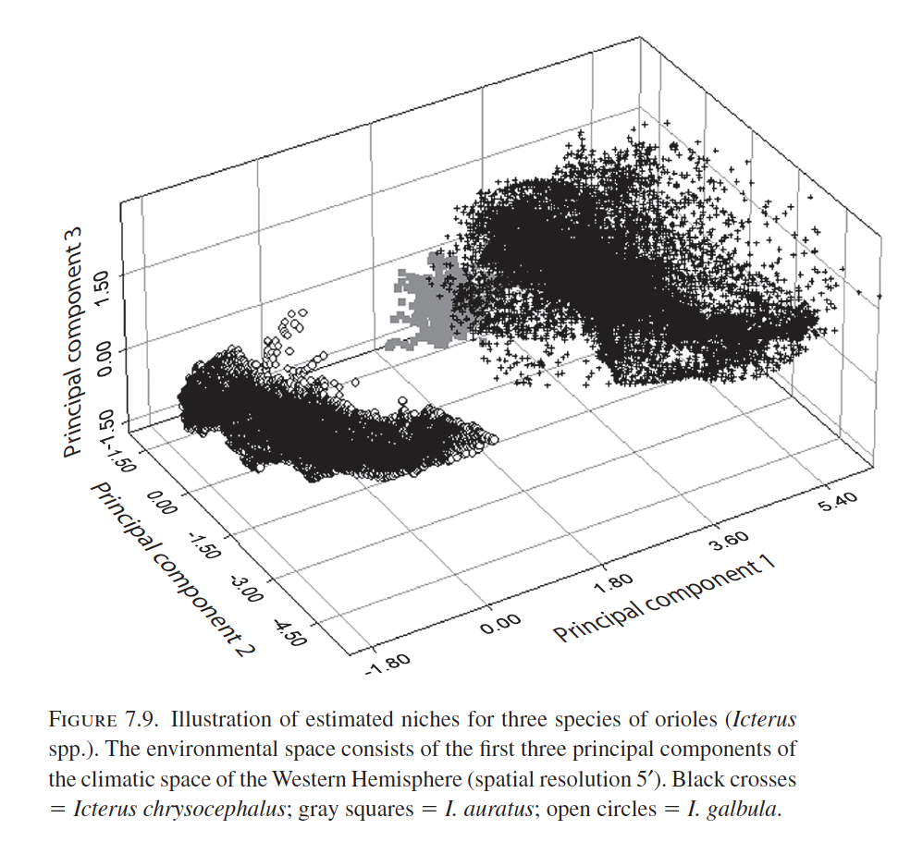
Characterizing niches in environmental space
Standardization and dimension reduction can help visualize complex environmental spaces.
Interpretation remains relative to the environmental conditions available within M.

Slide 28
Chapter 7 take-home message
A niche model is a set of linked scientific decisions.
Define the quantity you want to estimate before choosing an algorithm.
Match occurrence data, environmental predictors, study extent, and calibration choices to the biological question.
Prefer interpretable, biologically justified models over unnecessarily complex ones.
Treat predictions as hypotheses whose meaning depends on their assumptions.

Slide 29
Updates
I uploaded all the term project assignments
Read Peterson et al. Chapter 8 by next Tuesday

